Slide 1
15.S08 Recitation 3
Shuvomoy Das Gupta

Slide 2
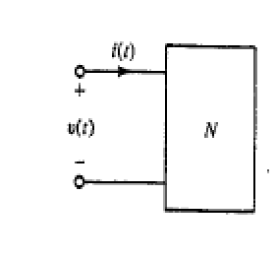




Complex power into a on-port
This is an assumption, they are never true sinusoids and exist alongside other higher frequency harmonic signals
But well-founded approximation because higher harmonics are usually small in magnitude
This is so, because most electric power is supplied by synchronous generator tightly operated around a nominal frequency
As renewable sources like wind and solar replace synchronous generators and dc current applications eg high voltage transmissions grow, the prevalence of this assumption may recede
* In north-America $ω=120π$
* In Europe $ω=100π$

Slide 3
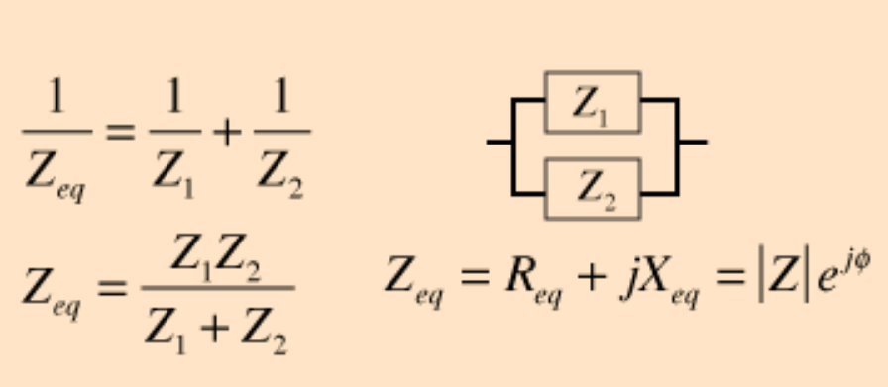
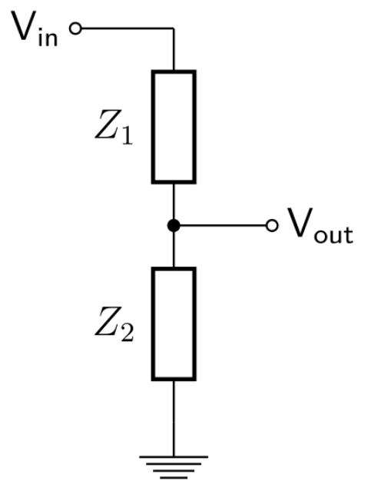
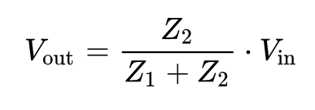



Parallel impedance
Different notations for phasors
Voltage divider rule

Slide 4
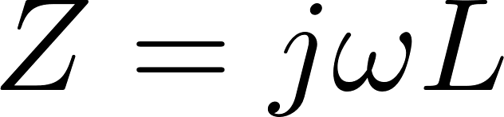


Reactive power
Intuition for reactive power
Consider the impedance:
We want to compute (a) the reactive power
(b) The instantaneous power into $L$
(c) Compare both

Slide 5




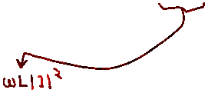







Intuition for reactive power
Consider the impedance:
We want to compute (a) the reactive power
(b) The instantaneous power into $L$
(c) Compare both

Slide 6






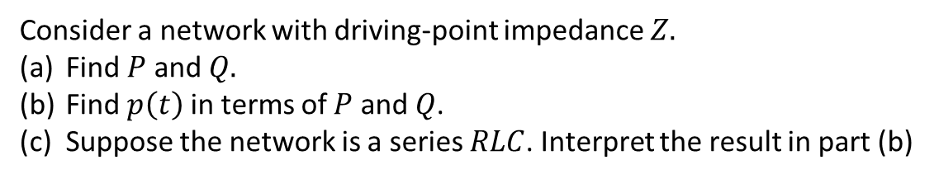






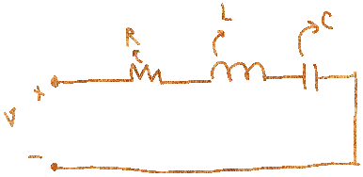



Intuition for reactive power
Consider a network with driving-point impedance $Z.$
Find $P$ and $Q.$
Find $p\left(t\right)$ in terms of $P$ and $Q$.
Suppose the network is a series $RLC$. Interpret the result in part (b)

Slide 7
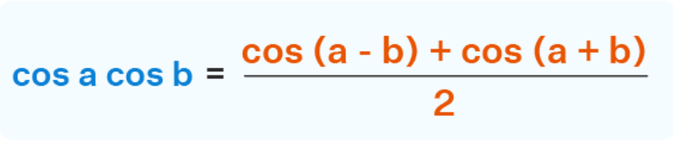






Slide 8


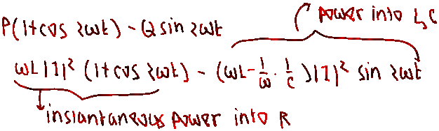



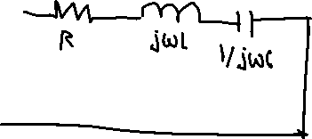






Slide 9
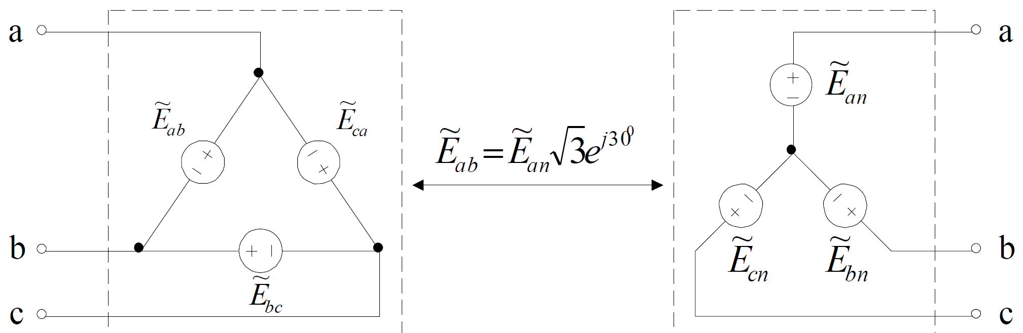
Delta-Wye Source Transformation
Suppose a balanced source is connected in a Delta
How to transform it to an equivalent Wye connected source?
Yes, we have just computed it!

Slide 10
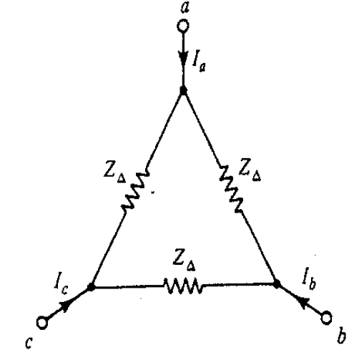
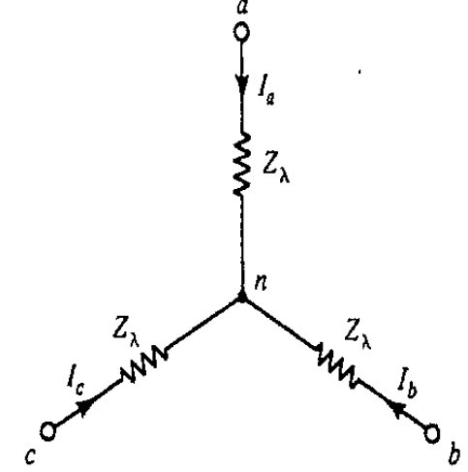

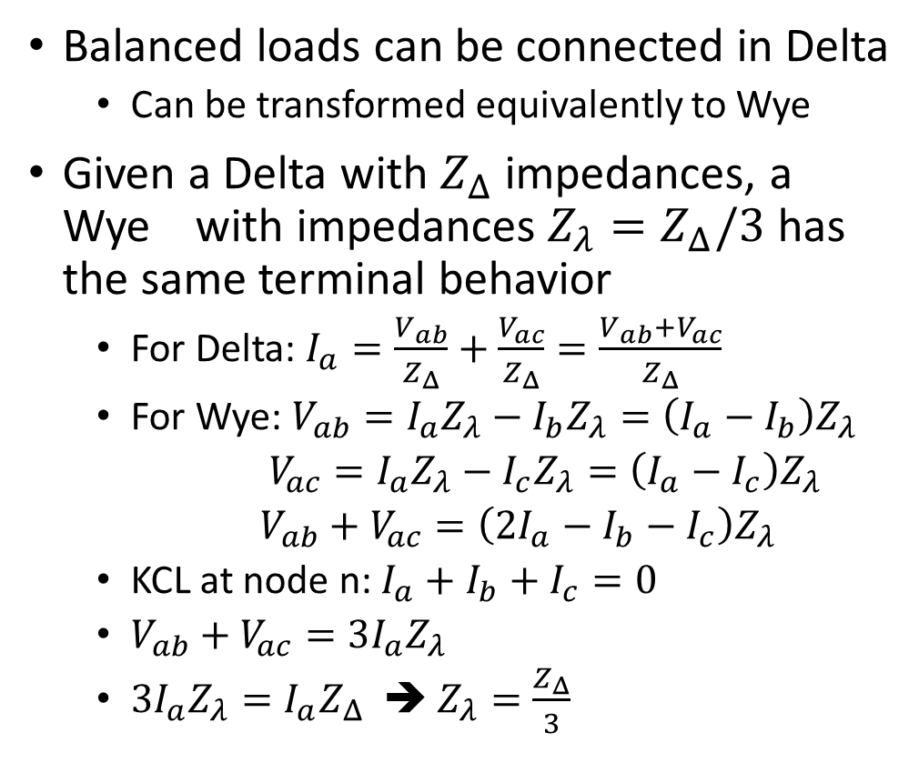
Derive: Delta-Wye Load Transformation
Balanced loads can be connected in Delta
Can be transformed equivalently to Wye
Given a Delta with $Z_{Δ}$ impedances, a Wye with impedances $Z_{λ}=Z_{Δ}/3$ has the same terminal behavior
For Delta: $I_{a}=\frac{V_{ab}}{Z_{Δ}}+\frac{V_{ac}}{Z_{Δ}}=\frac{V_{ab}+V_{ac}}{Z_{Δ}}$
For Wye: $V_{ab}=I_{a}Z_{λ}−I_{b}Z_{λ}=\left(I_{a}−I_{b}\right)Z_{λ}$
$V_{ac}=I_{a}Z_{λ}−I_{c}Z_{λ}=\left(I_{a}−I_{c}\right)Z_{λ}$
$V_{ab}+V_{ac}=\left(2I_{a}−I_{b}−I_{c}\right)Z_{λ}$
KCL at node n: $I_{a}+I_{b}+I_{c}=0$
$V_{ab}+V_{ac}=3I_{a}Z_{λ}$
$3I_{a}Z_{λ}=I_{a}Z_{Δ}$ ➔ $Z_{λ}=\frac{Z_{Δ}}{3}$

Slide 11
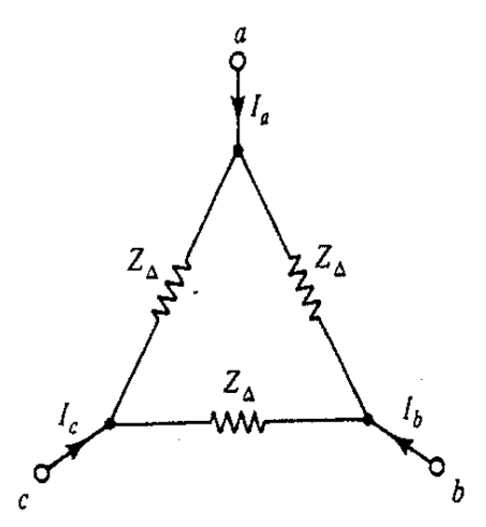
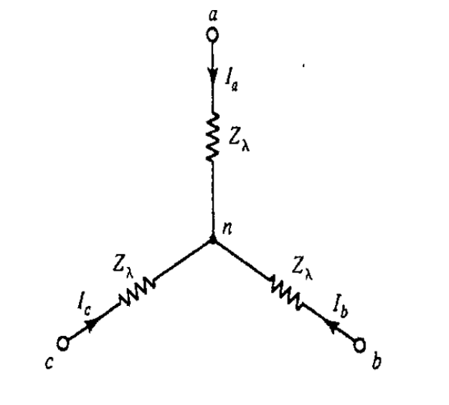

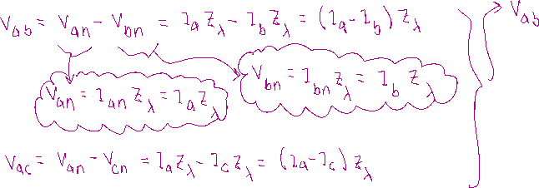



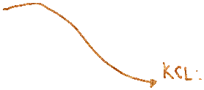
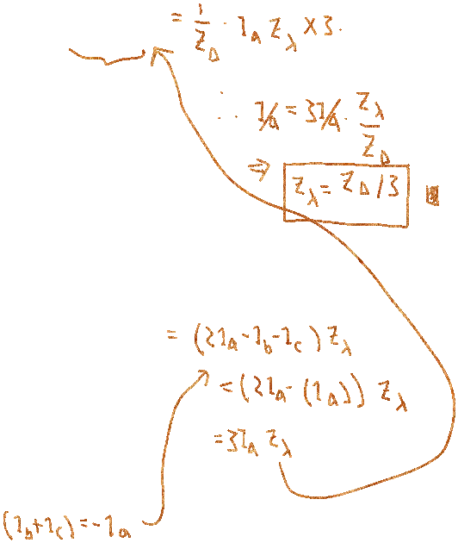
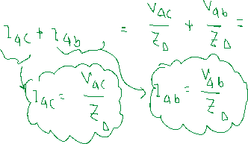


Slide 12
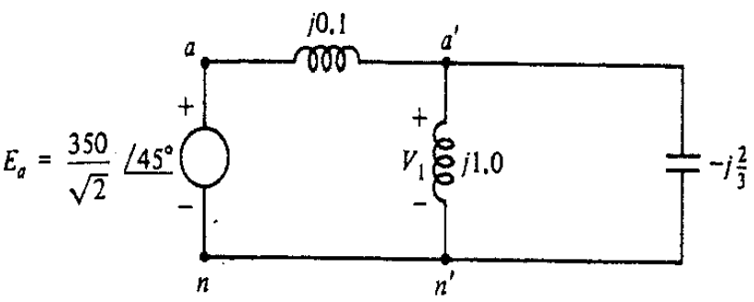

Per-Phase Analysis using Delta-Wye (Example 2.12)
3-phase balanced system can be analyzed using per-phase analysis
Example: find $v_{1}\left(t\right), i_{2}(t)$
Parallel impedance:
$\frac{j1.0⋅\left(−\frac{j2}{3}\right)}{j1.0−\frac{j2}{3}}=\frac{\frac{2}{3}}{\frac{j}{3}}=−j2$
$V_{1}=E_{a}⋅\frac{−j2}{j0.1−j2}=1.05E_{a}$
$v_{1}\left(t\right)=368.4\cos\left(ωt+{45}^{∘}\right)$
$V_{a^{′}b^{′}}=V_{1}\sqrt{3}e^{j{30}^{∘}}=\frac{638}{\sqrt{2}}e^{j{75}^{∘}}$
$I_{a^{′}b^{′}}=\frac{V_{a^{′}b^{′}}}{−j2}=\frac{319}{\sqrt{2}}e^{j{165}^{∘}}$
$i_{2}\left(t\right)=319\cos\left(ωt+{165}^{∘}\right)$

Slide 13
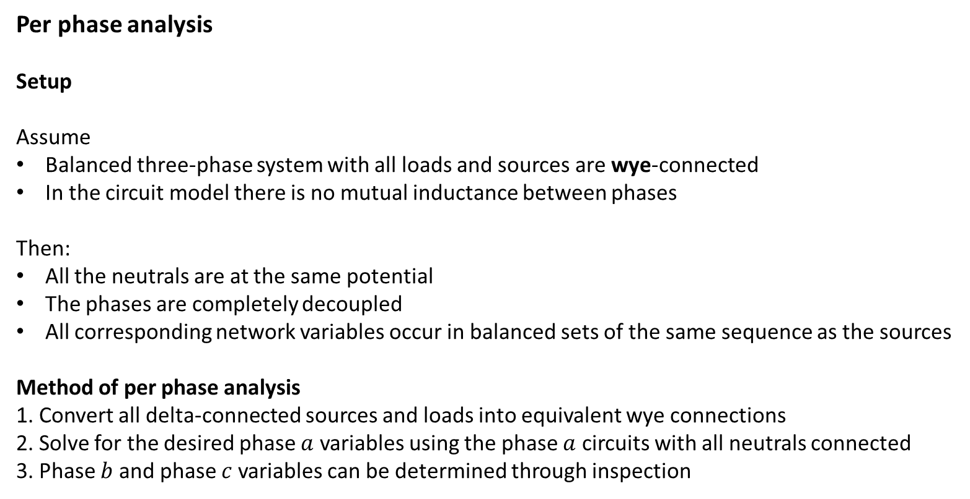
Per phase analysis
Setup
Assume
Balanced three-phase system with all loads and sources are wye-connected
In the circuit model there is no mutual inductance between phases
Then:
All the neutrals are at the same potential
The phases are completely decoupled
All corresponding network variables occur in balanced sets of the same sequence as the sources
Method of per phase analysis
1. Convert all delta-connected sources and loads into equivalent wye connections
2. Solve for the desired phase $a$ variables using the phase $a$ circuits with all neutrals connected
3. Phase $b$ and phase $c$ variables can be determined through inspection

Slide 14
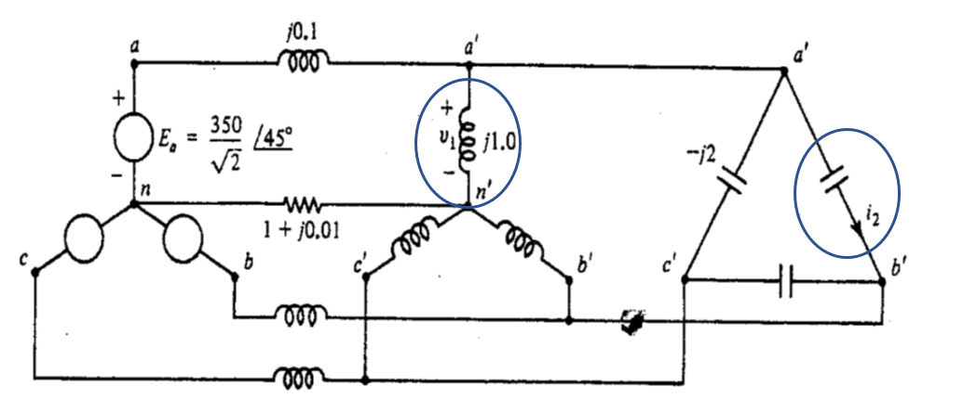
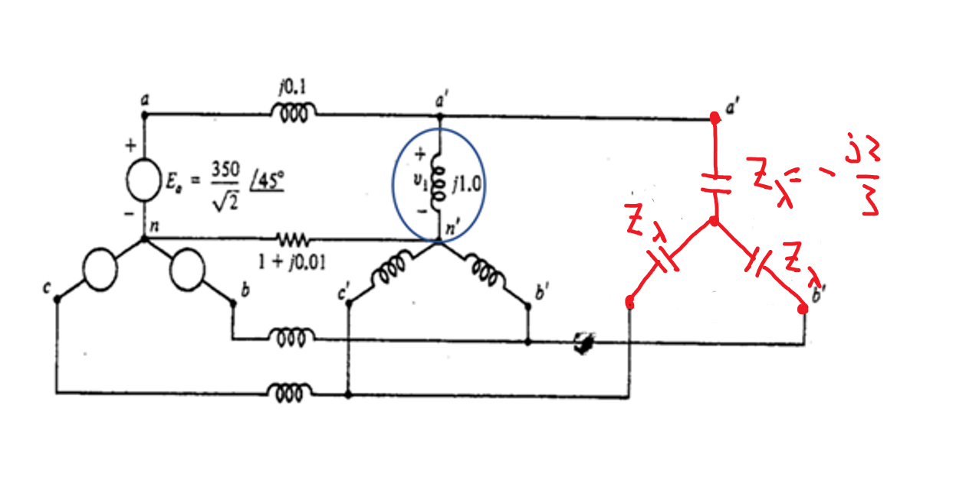
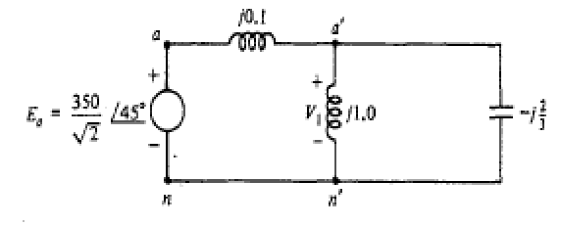



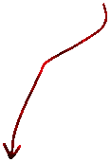








Slide 15


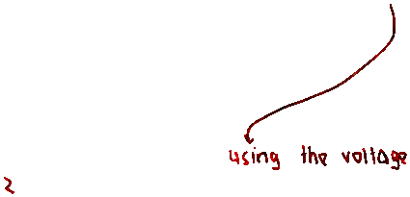

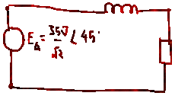



Slide 16








Slide 17




A realistic transmission line’s parameters
Suppose there is a 500kV line of 160 km (100 mi)
Total series resistance: $R=160×0.028=4.48Ω$
Total series reactance: $X_{L}=160×0.325=52.0Ω$
Total shunt admittance: $B_{C}=160×5.20×{10}^{−6}=8.32×{10}^{−4}$ S
If we use 250$Ω$ as the base for impedance, then
$R=\frac{4.48}{250}=0.018$ p.u., $X_{L}=\frac{52}{250}=0.208$ p.u.,
$B_{C}=8.32⋅{10}^{−4}⋅250=0.208$ p.u.
p.u. stands for per unit
This example could be skipped if no time
$$Z=0.02+j0.2$$
$$j0.1$$
$$j0.1$$

Slide 18
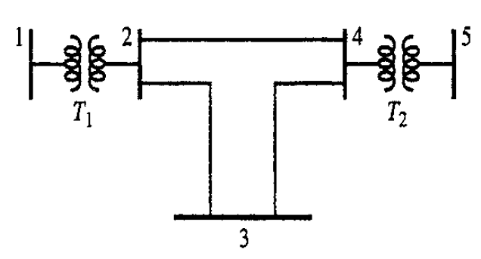




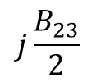
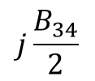




Admittance Matrix and Nodal Analysis
Consider a five-bus balanced three-phase system
Branch series impedance and total line-charging susceptance are p.u. under proper bases
Transmission lines $Π$-model with shunt susceptance
From Bus | To Bus | R (p.u.) | X (p.u.) | B (p.u.)
1 | 2 | 0.004 | 0.0533 | 0
2 | 3 | 0.02 | 0.25 | 0.22
3 | 4 | 0.02 | 0.25 | 0.22
2 | 4 | 0.01 | 0.15 | 0.11
4 | 5 | 0.006 | 0.08 | 0
$$y_{23}=1/(R_{23}+jX_{23})$$
$$y_{34}=1/(R_{34}+jX_{34})$$
$$+$$
$$V_{2}$$
$−$
$$+$$
$$V_{3}$$
$−$
$$+$$
$$V_{4}$$
$−$
$$j\frac{B_{23}}{2}$$
$$j\frac{B_{23}}{2}$$
$$j\frac{B_{34}}{2}$$
$$j\frac{B_{34}}{2}$$
neutral
neutral

Slide 19
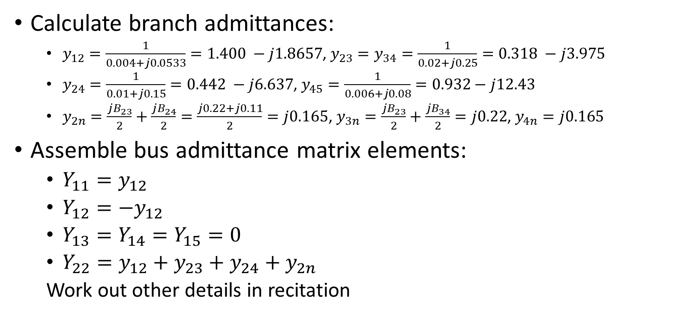
Example (cont.)
Calculate branch admittances:
$y_{12}=\frac{1}{0.004+j0.0533}=1.400 −j1.8657$, $y_{23}=y_{34}=\frac{1}{0.02+j0.25}=0.318 −j3.975$
$y_{24}=\frac{1}{0.01+j0.15}=0.442 −j6.637$, $y_{45}=\frac{1}{0.006+j0.08}=0.932−j12.43$
$y_{2n}=\frac{jB_{23}}{2}+\frac{jB_{24}}{2}=\frac{j0.22+j0.11}{2}=j0.165$, $y_{3n}=\frac{jB_{23}}{2}+\frac{jB_{34}}{2}=j0.22$, $y_{4n}=j0.165$
Assemble bus admittance matrix elements:
$Y_{11}=y_{12}$
$Y_{12}=−y_{12}$
$Y_{13}=Y_{14}=Y_{15}=0$
$Y_{22}=y_{12}+y_{23}+y_{24}+y_{2n}$
Work out other details in recitation

Slide 20
Power transmission in a line
Example 4.8

